Slide 1
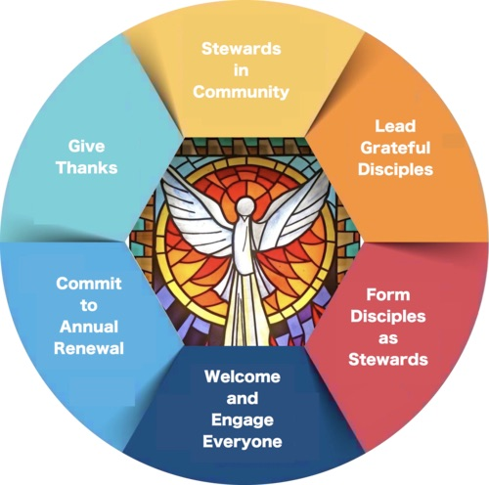
Becoming Stewards Saints Peter & Paul Parish
2019 Stewardship Plan

Slide 2
Winter / Ordinary Time
“Not only are people’s lives changed…when parishes form parishioners as disciples and stewards, the parish itself is transformed”( Lisa Anslinger, “Grateful Disciples”)
Aligns to Goals:
Welcome
Faith Formation
Formation / Communication How & Who? Welcome How & Who? Faith Formation How & Who?
Bring forward an understanding of Stewardship to the parish. Improve Communication Use OPL 2019 Calendar: Becoming Stewards L. A. Bulletin Inserts | Don Prescavage to lead; Introduce Stewardship by creating script for each Mass, PPC & Committee Mtgs Gather all parishioner emails Use small Offertory baskets to pass so that all may be a part of the Offertory | Grow Hospitality Ministry | K Grinaway continue to organize and grow Greeters Parking Lot Hospitality | Invite parishioners to gather for video and small group discussion. RCIA | Begin in Lent- Father Jack/Deacon Don to lead Ben Berrini leads RCIA Program / reapplies program strengths from other parishes

Slide 3
Lent
“The parish is more than simply the place where people come to Mass or participate in sacramental preparation.
The parish is a community of believers who are committed to Christ and to living as disciples” (Leisa Anslinger, “Grateful Disciples”)
Aligns to Goals:
Welcome
Faith Formation
Formation / Communication How & Who? Welcome How & Who? Faith Formation How & Who?
Bring forward understanding of Stewardship to the parish. Use OPL 2019 Calendar: Becoming Stewards Leisa A. Bulletin Inserts | K. Grinaway to lead; Introduce Stewardship by creating script for each Mass, PPC & Committee Mtgs | Grow Hospitality Ministry | K Grinaway continue to organize and grow Greeters Parking Lot Hospitality | Invite parishioners to gather for video and small group discussion. RCIA | Use Barron’s Catholicism Video Series. Father Jack/Deacon Don to lead. Ben Berrini leads RCIA Program / reapplies program strengths from other parishes

Slide 4
Easter
“Stewardship is an expression of discipleship with the power to change how we understand and live our lives” (Stewardship, a Disciple’s Response, Introduction)
Aligns to Goals:
Welcome
Faith Formation
Formation / Communication How & Who? Welcome How & Who? Faith Formation How & Who?
Bring forward an understanding of Stewardship to the parish. Use OPL 2019 Calendar: Becoming Stewards L. A. Bulletin Inserts | Paul Dreabit to lead; Introduce Stewardship by creating script for each Mass, PPC & Committee Mtgs | Grow Hospitality Ministry | K Grinaway continue to organize and grow Greeters Parking Lot Hospitality | Invite parishioners to gather for video and small group discussion. RCIA | Use Barron’s Catholicism Video Series. Father Jack/Deacon Don to lead Ben Berrini leads RCIA Program / reapplies program strengths from other parishes

Slide 5
Pentecost
“For disciples of Christ - everyone who responds to Jesus’ invitation , ‘Come follow me’ – Christian stewardship is an obligation, not an option” (Stewardship, a Disciple’s Response, 14)
Aligns to Goals:
Welcome
Faith Formation
Formation / Communication How & Who? Welcome How & Who? Faith Formation How & Who?
Bring forward an understanding of Stewardship to the parish. Use OPL 2019 Calendar: Becoming Stewards L. A. Bulletin Inserts | Fr J Lambert to lead; Promote an attitude of Stewardship | Grow Hospitality Ministry | K Grinaway continue to organize and grow Greeters Parking Lot Hospitality | Invite parishioners to gather for video and small group discussion. RCIA | Use Barron’s Catholicism Video Series. Father Jack/Deacon Don to lead Ben Berrini leads RCIA Program / reapplies program strengths from other parishes

Slide 6
Summer / Ordinary Time
Aligns to Goals:
Welcome
Faith Formation
Formation / Communication How & Who? Welcome How & Who?
Bring forward an understanding of Stewardship to the parish. Use OPL 2019 Calendar: Becoming Stewards L. A. Bulletin Inserts | Fr J Lambert to lead; Promote an attitude of Stewardship | Grow Hospitality Ministry in new ways | K Grinaway continue to organize and grow Greeters Parking Lot Hospitality

Slide 7
Autumn / Ordinary Time
Aligns to Goals:
Welcome
Faith Formation
Formation / Communication How & Who? Welcome How & Who? Faith Formation How & Who?
Bring forward an understanding of Stewardship to the parish. Use OPL 2019 Calendar: Becoming Stewards Stewardship Ministry Info Fair | B. Berrini to lead; Promote an attitude of Stewardship Create script for each Mass, PPC & Committee Mtgs K Grinaway | Grow Hospitality Ministry in new ways | K Grinaway continue to organize and grow Greeters Parking Lot Hospitality | RCIA | Ben Berrini leads RCIA Program / reapplies program strengths from other parishes

Slide 8
Advent / Christmas
“The change of mind, heart, and life that is brought about by embracing stewardship does not happen overnight. Because the circumstances of our lives change daily, growth as a disciple and good steward is a continual process of conversion” ( Lisa Anslinger, “Grateful Disciples”)
Aligns to Goals:
Welcome
Faith Formation
Formation / Communication How & Who? Welcome How & Who? Faith Formation How & Who?
Bring forward an understanding of Stewardship to the parish. Use OPL 2019 Calendar: Becoming Stewards Stewardship Ministry – Sign-up | Kathy Grinaway to lead Promote an attitude of Stewardship at PPC & Committee Mtgs | Grow Hospitality Ministry in new ways All Souls / Bereavement Mass | K Grinaway continue to organize and grow Greeters Parking Lot Hospitality Hospitality | RCIA | Ben Berrini leads RCIA Program / reapplies program strengths from other parishes

Slide 9
Thank you for taking this journey with us
Ben Berrini
Paul Dreabit
Deacon Don Crane
Kathy Grinaway
Don Prescavage
Fr. Jack Lambert

